Slide 1
iTest
Analysis Presentation
Fábio Magalhães – A75030
Rui Carvalho – A76279

Slide 2
Agenda
Problem Statement
Market Study
Constrains
Requirements
Specifications
System Overview
Events
Use Cases
State Chart
Sequence Diagram
System Stack
Flowcharts
Software System Overview
Task Priority
Gantt

Slide 3
Problem Statement
In today society mankind is constantly using digital devices, that are affecting, negatively, vision health. It's been a concern for the past years to fight this era’s side-effect. To get yourself diagnosed, you must go to a doctor, which in public healthcare means a long wait and sometimes may be costly.
The Project’s goal is to design a tool to help diagnose irregularities in human vision, such as astigmatism, near-sightedness, and colour blindness. With only one device the user will be able to self-diagnose in an interactive and fast way.
The system will have a screen showing images, that the user must identify. The device will recognise the answer and evaluate it. In the end of the test it will give you a result of how good or not your vision is.

Slide 4


C!!
A!!
A
E
X
✓

Slide 5
Market Study
There are already a lot of vision diagnostics devices. Although these devices are all equipment that should be handle by a professional technician, we found some that compare to our project.

Slide 6
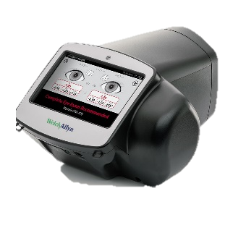
Market Study
SPOT Vision Screener:
Professional, portable device. Unlike ours, the device diagnoses the patient through a camera, screening the eye directly. This equipment is extremely expensive.

Slide 7
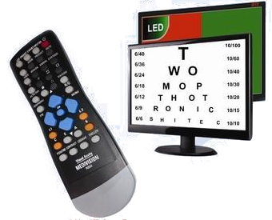
Market Study
Medivision Digital Acuity Chart:
Similar to our project, it displays the test in a screen. Although the diagnostic must be made by a doctor/technician, as the device will not give any. The device, though cheaper than SPOT, is still very expensive.

Slide 8
Market Study
Resuming there exists already good devices that perform the task, but they are very expensive and they all need an experienced technician to use them.

Slide 9
Constraints
Budget must be minimal.
Project developed by a team of two.

Slide 10
Technical Constraints
STM32F4-DISCOVERY board
Keil uVision MDK-ARM
Digital Signal Processor (DSP)
FreeRTOS
Minimum of three sensors
Machine Learning

Slide 11
Functional Requirements
Diagnose User
Display the vision test on the TFT screen.
Detect user interaction.
Measure the distance between the device and the patient.
Check suitability of the ambient light.
Recognise speech input data.
Show malfunctions on the display.
Give audio signals.

Slide 12
Non-Functional Requirements
Low Cost and low power.
User-friendly interface.
Small and portable.
The system must have low latency.

Slide 13
Hardware Specifications
STM32f4 Discovery Board
STM32F407VGT6 MCU
32-bit ARM Cortex-M4 CPU with FPU core
1-Mbyte Flash Memory
192-Kbyte RAM
MP45DT02 ST MEMS Digital Microphone
CS43L22 Audio DAC
Up to 17 timers
3 ADC 12-bit (up to 24 channels)
General-Purpose DMA
Light sensor
LDR 1K-10K Ω
Ultrasonic distance measurement
HC-SR04
2-400 cm of non-contact measurement
MEMS Digital Microphone onboard
TFT w/ Touchscreen
ILI9488 Display Driver
320x480 Resolution
Resistive Touchscreen

Slide 14
STM32F4 Discovery Board
The STM32F4DISCOVERY Discovery allows development with the STM32F407VG high performance microcontroller with the ARM® Cortex®-M4 32-bit core.
Based on STM32F407VG, it includes an ST-LINK/V2 embedded debug tool, two ST-MEMS digital accelerometers, a digital microphone, one audio DAC with integrated class D speaker driver, LEDs, push buttons and a USB OTG micro-AB connector.

Slide 15
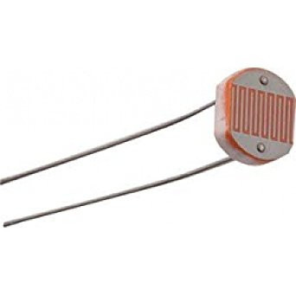
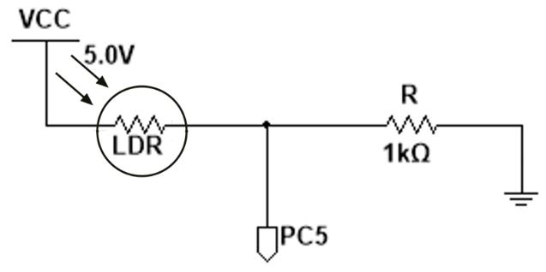
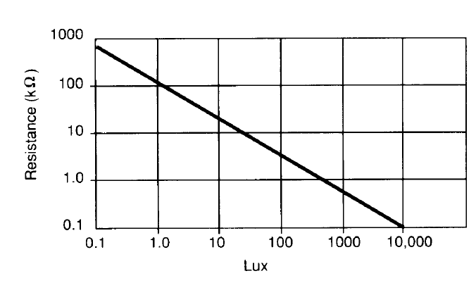
LDR

Slide 16
LDR
Specifications
Interface
Bright Resistance (100 lux) | 5k Ω
Dark Resistance (10 lux) | 10k Ω
Very Bright Resistance (100 lux) | 400 Ω
Max Voltage | 150 V
Max Power | 100 mW
Ambient Temperature Range | -30 ~ +70 °C
 | Pin Name | Pin Function
LDR OUT | PC5 | ADC12_IN15

Slide 17
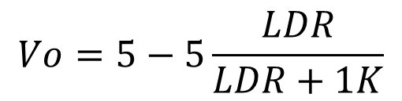
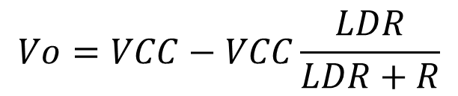
LDR
$$Vo=VCC−VCC\frac{LDR}{LDR+R}$$
$$Vo=5−5\frac{LDR}{LDR+1K}$$
Best ambient light (250 lux) -> 2.5k Ω
Light Level | Expected Output | Real output
Bright (100 lux) | 0.83 V
Dark (10 lux) | 0.45 V
Good Lighting (250 lux) | 1.43 V

Slide 18
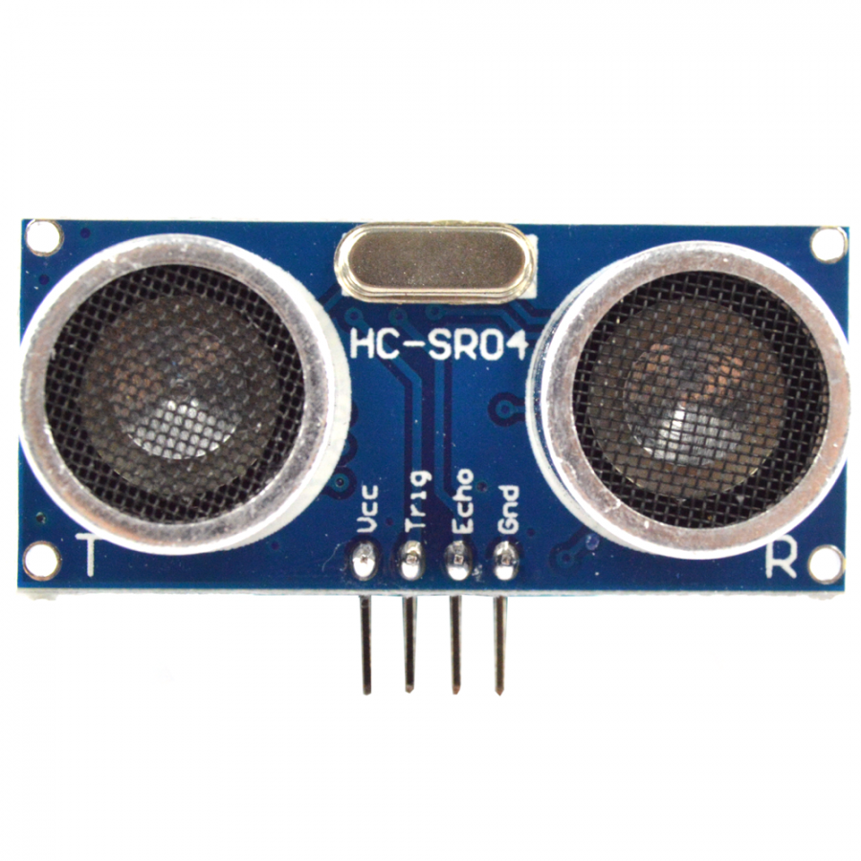
HC-SR04

Slide 19
HC-SR04
Specifications
Interface
Working Voltage | 5V
Working Current | 15mA
Working Frequency | 40KHZ
Max Range | 4m
Min Range | 2cm
Measuring Angle | 15°
Trigger Input Signal | 10us TTL pulse
 | Pin Name | Pin Function
Trig | PA1 | Out
Echo | PA0 | TIM2_CH2

Slide 20
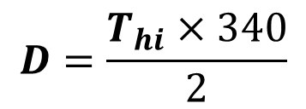
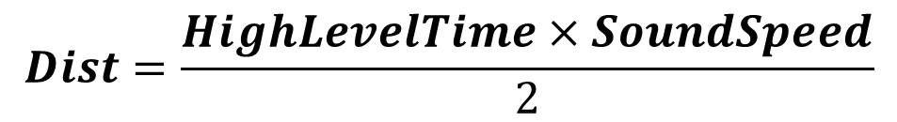
HC-SR04
Test Cases
$$Dist=\frac{HighLevelTime×SoundSpeed}{2}$$
$$D=\frac{T_{hi}×340}{2}$$
Distance | Expected Output | Real output
Min (2 cm) | 2 cm
Max (400 cm) | 400 cm
Reference (150 cm) | 150 cm

Slide 21
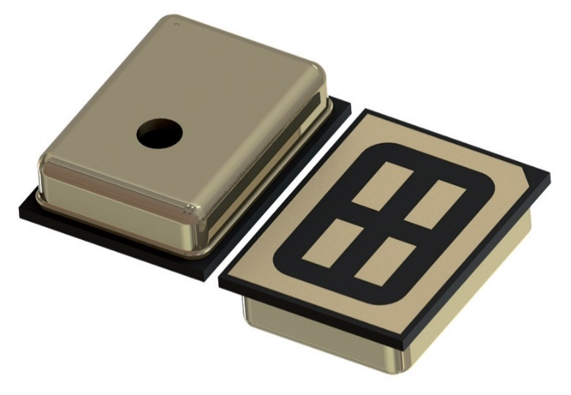
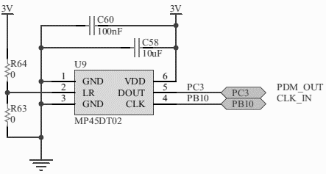
Microphone

Slide 22
Microphone
Specifications
Interface
Parameter | Min | Typical | Max
Supply voltage | 1.6V | 1.8V | 3.6V
Current in normal mode |  | 0.65mA
Current in power-down mode |  | 0.20mA
Sensitivity | -29dBFS | -26dBFS | -23dBFS
Input clock frequency | 1 MHz | 2.4MHz | 3.25 MHz
 |  |  | 10ms
Low level logic voltage | -0.3 V |  | 0.35*Vdd
High level logic i voltage | 0.65*Vdd |  | Vdd+0.3
 | Pin Name | Pin Function
PDM Out | PC3
Clock | PB10 | TIM2_CH3

Slide 23


Microphone
Test Case
 | Expected Output | Real output
Speak to microphone | Voice input

Slide 24
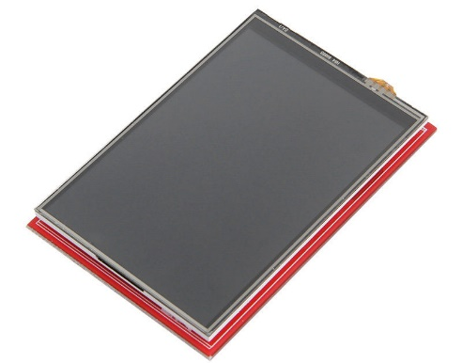
Display
ILI9488 Display Driver
SPI Compatible

Slide 25
Display
Specifications
Interface
Resolution | 320x480
Frame Memory | 345 kbytes
Input Image | 24 bits
IO VCC | 1.65 – 3.3 V
Temperature | -40 ~ +85 °C
 | Pin Name | Pin Function
SCK | PA5 | SPI1_SCK
MISO | PA6 | SPI1_MISO
MOSI | PA7 | SPI1_MOSI

Slide 26
Display
Test Cases
Send command through SPI
Send Command | Expected Output | Real output
0x01 | Module Resets
0x04 | Manufacturer, Version, ID

Slide 27
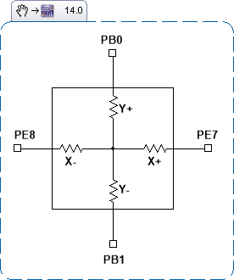
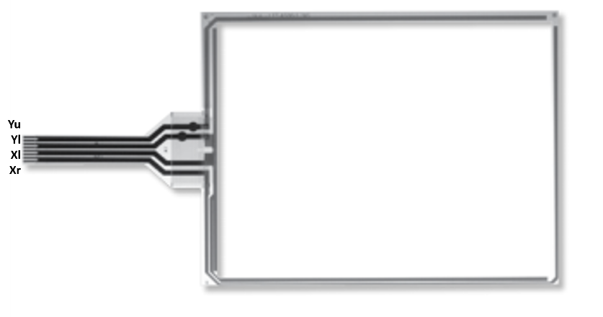
Resistive Touchscreen

Slide 28
Resistive Touchscreen
Size: 74*49 mm
Interface
Test Cases
 | Pin Name | Pin Function
Y+ | PB0 | ADC12_IN8, GPIO IN/OUT
Y- | PB1 | ADC12_IN9, GPIO IN/OUT
X+ | PE7 | GPIO IN/OUT
X- | PE8 | GPIO IN/OUT
Touch | Expected Output (X,Y) | Real output (X,Y)
Right Top Corner | 0,49 mm
Right Bottom Corner | 0,0 mm
Left Top Corner | 74,49 mm
Left Bottom Corner | 74,0 mm

Slide 29
Software Specifications
Keil uVison MDK-V5
FreeRTOS
C Language
MatLab

Slide 30
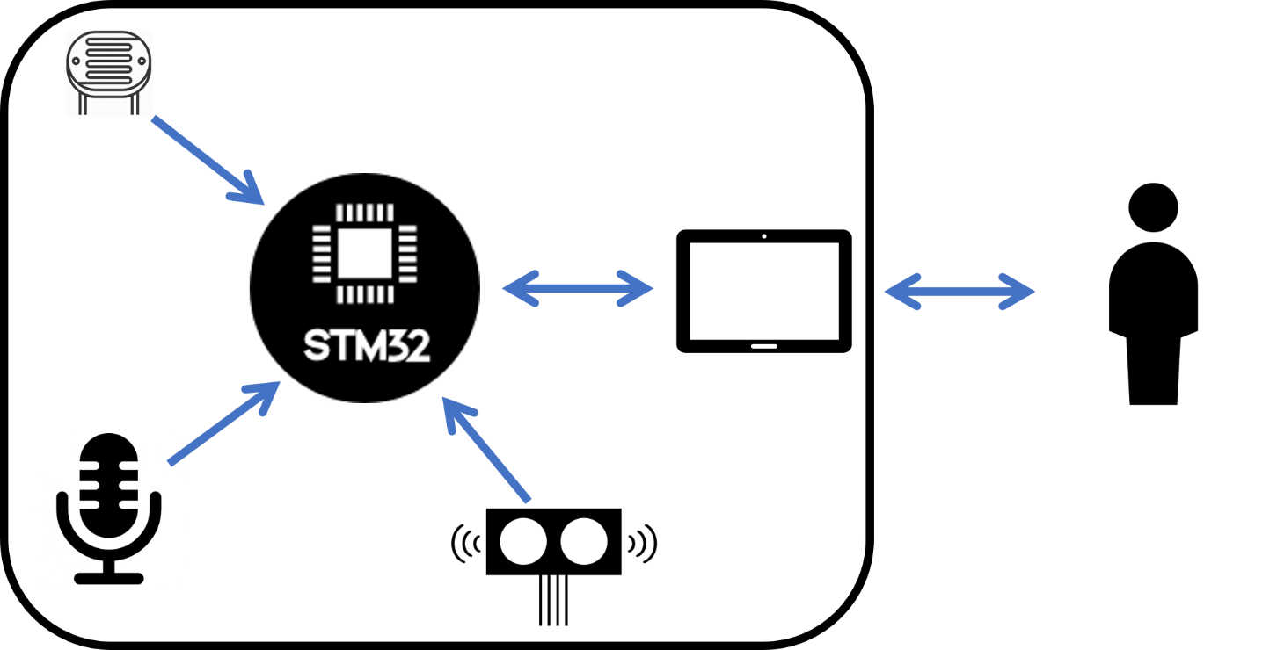
System Overview

Slide 31
Events
Event | System Response | Source
On/Off | Turn System On/Off | User
Read Light | Reads ADC and processes data | Local Sys
Read Distance | Gets distance value | Local Sys
Display | Changes display data | Local Sys
Get voice | Gets and recognises voice input | User
Get Touch | Gets user input on touchscreen | User

Slide 32
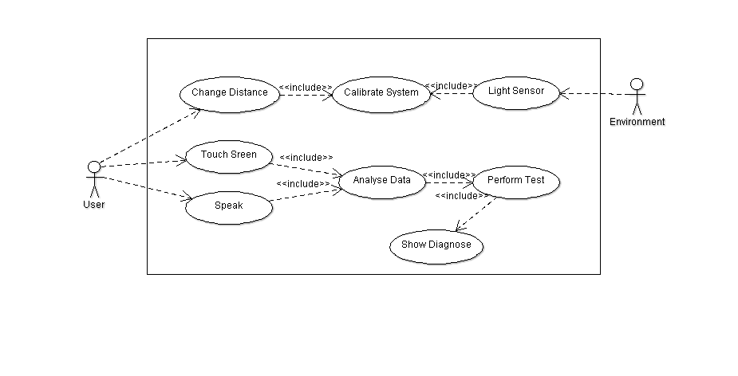
Use Cases

Slide 33
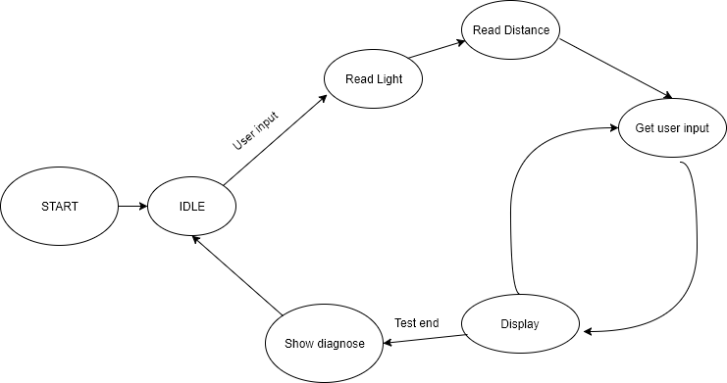
State Chart

Slide 34
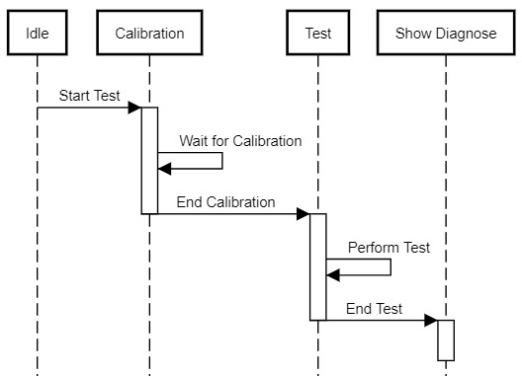
Sequence Diagram

Slide 35
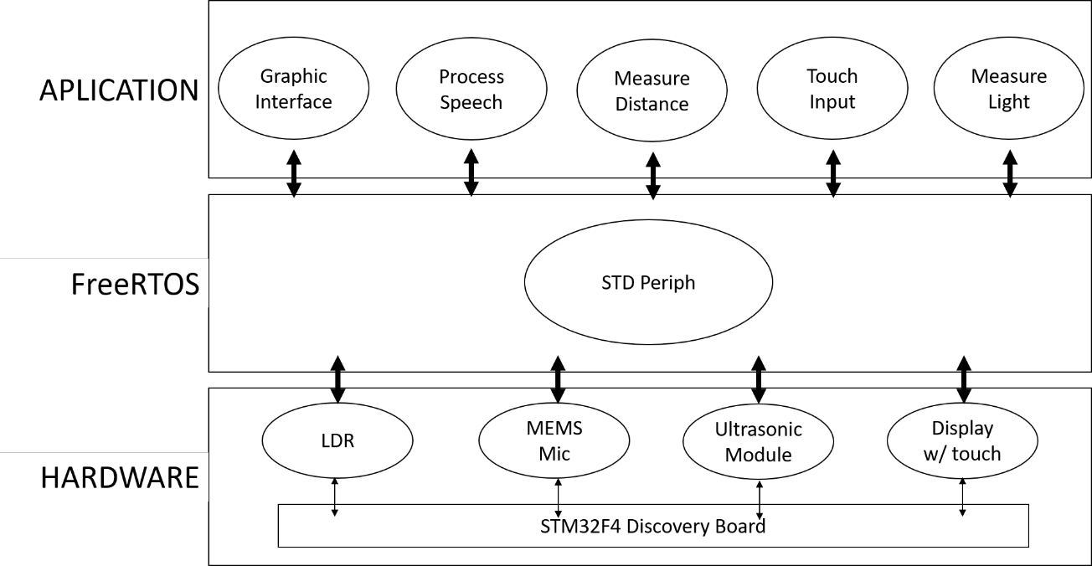
System Stack

Slide 36
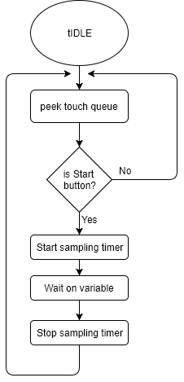
Flowcharts

Slide 37
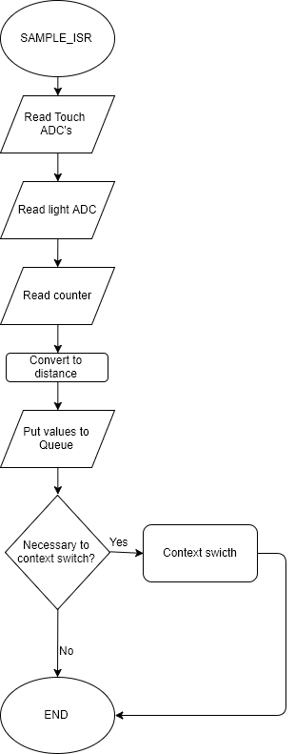
Flowcharts

Slide 38
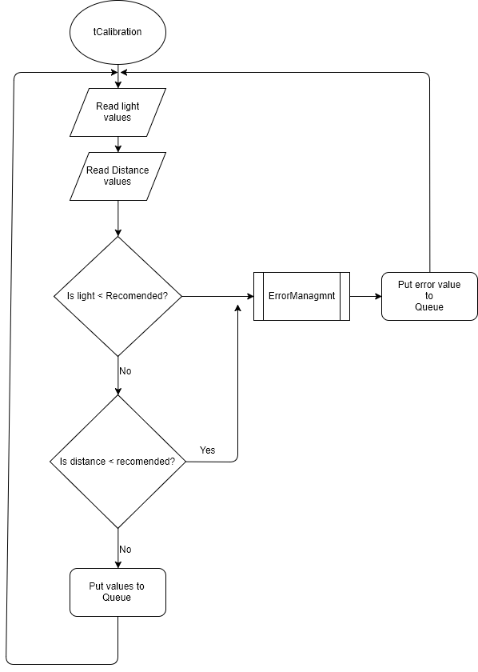
Flowcharts

Slide 39
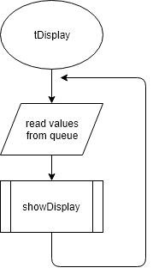
Flowcharts

Slide 40
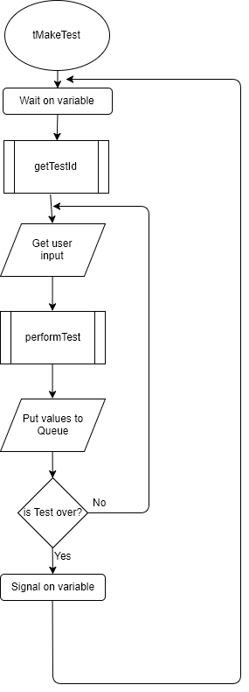
Flowcharts

Slide 41
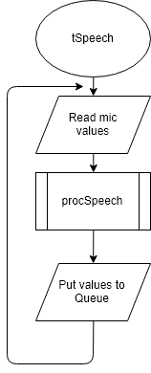
Flowcharts

Slide 42
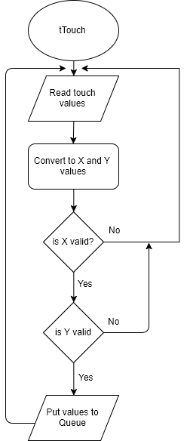
Flowcharts

Slide 43
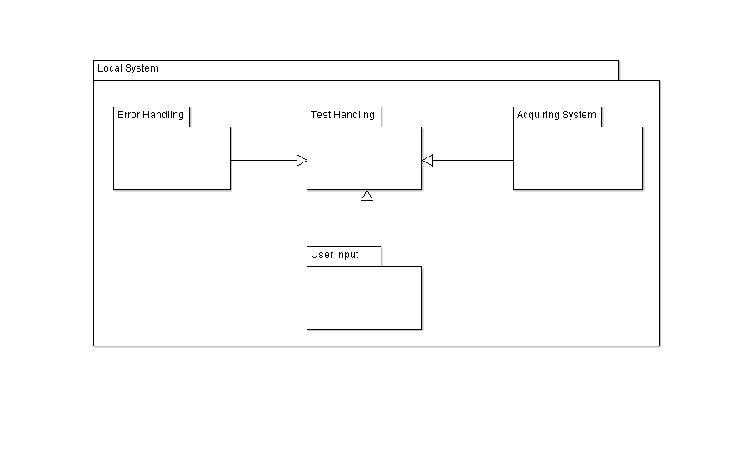
Software System Overview

Slide 44
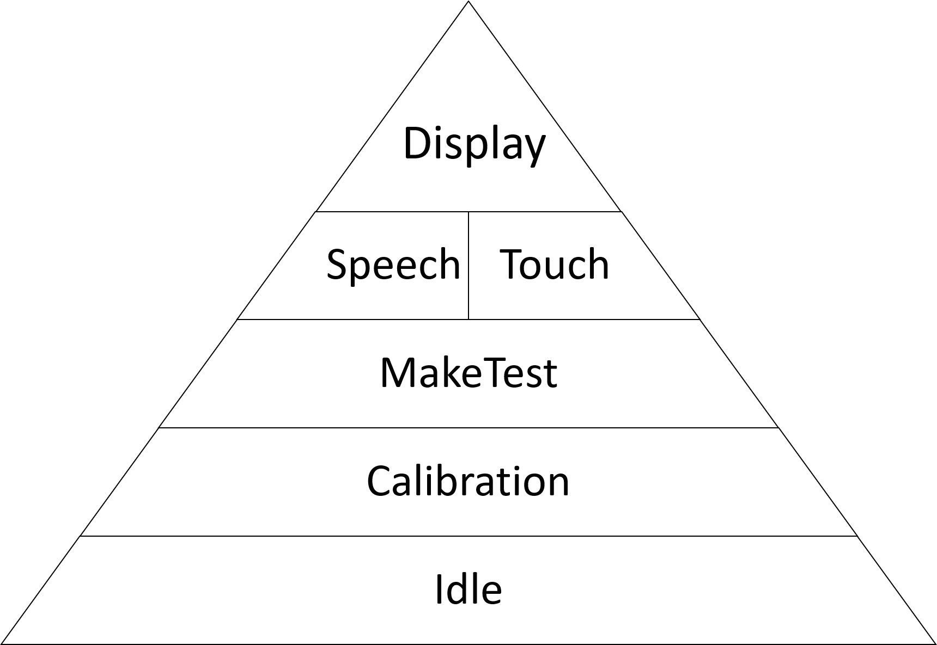
Task Priority

Slide 45
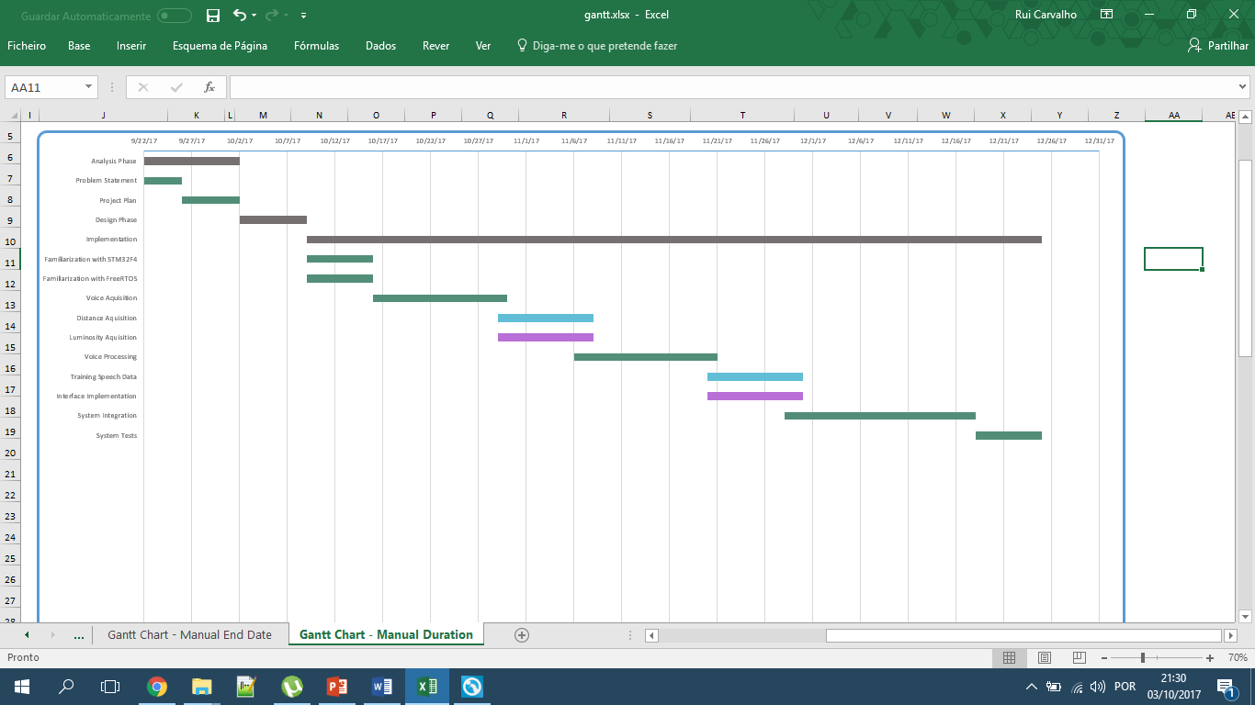
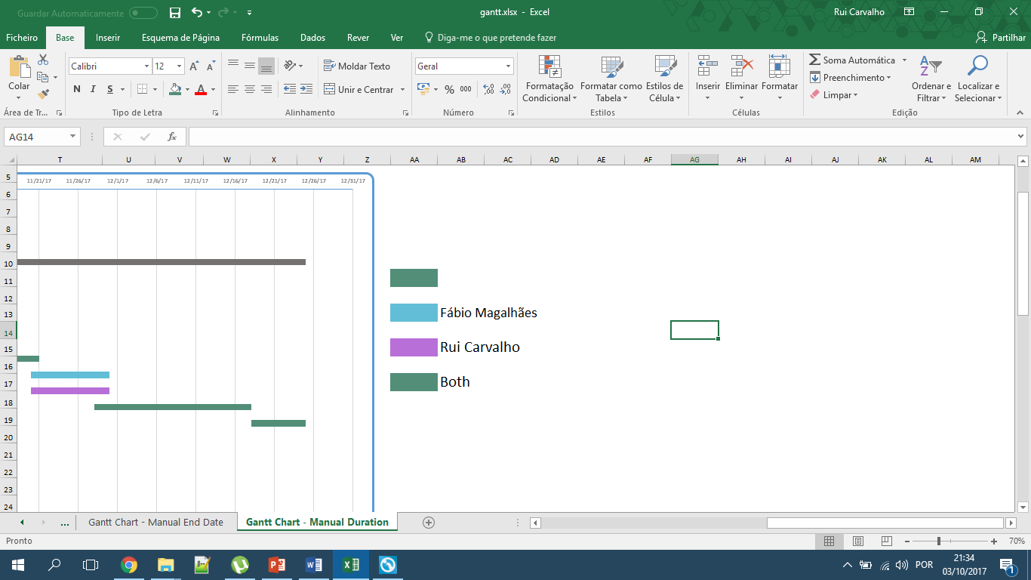
Gantt Chart

Slide 46
QUESTIONS?

